Slide 1
Module 2.0
Linear Data Structure: Linked List

Slide 2
Memory Allocation & Deallocation for Linked List

Slide 3
Memory Allocation
There are two types of Memory Allocation
Compile Time or Static Allocation
Runtime or Dynamic Allocation

Slide 4
Compile Time or Static Allocation
Memory allocated to the program element
at the start of the program.
Memory allocated
is fixed and determined by the compiler at compile time.
Eg- float a[5] ,
allocation of 20 bytes to the array, i.e. 5*4 bytes

Slide 5
Compile Time or Static Allocation-Disadvantages
Inefficient Use of Memory-
Can cause under utilization of memory in case of over allocation
That is if you store less number of elements than the number for elements which you have declared memory.
Rest of the memory is wasted, as it is not available to other applications.

Slide 6
Compile Time or Static Allocation
Inefficient Use of Memory-
Can cause Overflow in case of under allocation
For float a[5];
No bound checking in C for array boundaries, if you are entering more than fives values,
It will not give error but when these extra element will be accessed, the values will not be available.

Slide 7
Compile Time or Static Allocation
No reusability of allocated memory
Difficult to guess the exact size of the data at the time of writing the program

Slide 8
Runtime or Dynamic Allocation
All Linked Data Structures are preferably implemented through dynamic memory allocation.
Dynamic data structures provide flexibility in adding, deleting or rearranging data objects at run time.
Managed in C through a set of library functions:
malloc()
Calloc()
free()
Realloc()

Slide 9
Runtime or Dynamic Allocation
Memory space required by Variables is calculated and allocated during execution
Get Required chunk of memory at Run time or As the need arises
Best Suited –
When we do not know the memory requirement in advance, which is the case in most of the real life problems.

Slide 10
Runtime or Dynamic Allocation
Efficient use of Memory
Additional Space can be allocated at run time.
Unwanted Space can be released at run time.
Reusability of Memory space

Slide 11
The malloc() fn
Allocates a block of memory in bytes
The user should explicitly give the block size needed.

Slide 12
The malloc() fn
Request to the RAM of the system to allocate memory,
If request is granted returns a pointer to the first block of the memory
If it fails, it returns NULL

Slide 13
The malloc() fn
The type of pointer is Void, i.e. we can assign it any type of pointer.
Available in header file alloc.h or stdlib.h

Slide 14
The mallloc() fn
Syntax-
ptr_var=(type_cast*)malloc(size)

Slide 15
The mallloc() fn
Syntax-
ptr_var=(type_cast*)malloc(size)
ptr_var = name of pointer that holds the starting address of allocated memory block
type_cast* = is the data type into which the returned pointer is to be converted
Size = size of allocated memory block in bytes

Slide 16
The mallloc() fn
Eg-
int *ptr;
ptr=(int *)malloc(10*sizeof(int));

Slide 17
The mallloc() fn
Eg-
int *ptr;
ptr=(int *)malloc(10*sizeof(int));
Size of int=2bytes
So 20 bytes are allocated,
Void pointer is casted into int and assigned to ptr

Slide 18
The mallloc() fn
Eg-
char *ptr;
ptr=(char *)malloc(10*sizeof(char));

Slide 19
The mallloc() fn- Usage in Linked List
Eg-
struct student;
{
int roll_no;
char name[30];
float percentage;
};
struct student *st_ptr;
st_ptr=(struct student *)malloc(10*sizeof(struct student));

Slide 20
The callloc() fn
Similar to malloc
It neds two arguments as against one argument in malloc() fn
Eg-
int *ptr;
ptr=(int *)calloc(10,2));
1st argument=no of elements
2nd argument=size of data type in bytes

Slide 21
The callloc() fn
Available in header file alloc.h or stdlib.h

Slide 22
Malloc() vs callloc() fn
Initialization:
malloc() doesn’t initialize the allocated memory.
If we try to access the content of memory block(before initializing) then we’ll get segmentation fault error(or garbage values).
calloc() allocates the memory and also initializes the allocated memory block to zero.
If we try to access the content of these blocks then we’ll get 0.

Slide 23
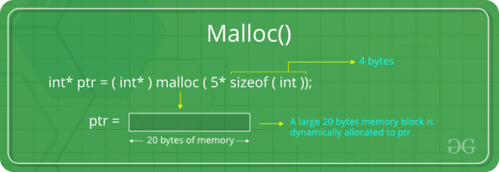
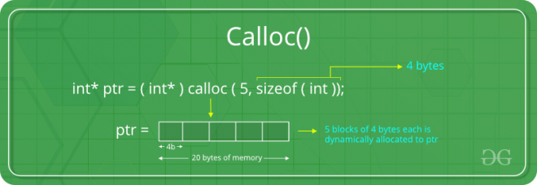
Malloc() vs callloc() fn
Malloc
allocate a single large block of memory with the specified size.
Calloc
allocate multiple blocks of memory
dynamically allocate the specified number of blocks of memory of the specified type.

Slide 24
The free() fn
Used to deallocate the previously allocated memory using malloc or calloc() fn
Syntax-
free(ptr_var);
ptr_var is the pointer in which the address of the allocated memory block is assigned.
Returns the allocated memory to the system RAM..

Slide 25
What happens when you don’t free memory after using malloc()
The memory allocated using malloc() is not de-allocated on its own.
So, “free()” method is used to de-allocate the memory.
But the free() method is not compulsory to use.

Slide 26
What happens when you don’t free memory after using malloc()
If free() is not used in a program
the memory allocated using malloc() will be de-allocated
after completion of the execution of the program
(included program execution time is relatively small and the program ends normally).

Slide 27
What happens when you don’t free memory after using malloc()
Still, there are some important reasons to free() after using malloc():
Use of free after malloc is a good practice of programming.
There are some programs like a digital clock, a listener that runs in the background for a long time and there are also such programs which allocate memory periodically.

Slide 28
What happens when you don’t free memory after using malloc()
Still, there are some important reasons to free() after using malloc():
In these cases, even small chunks of storage add up and create a problem.
Thus our usable space decreases.
This is also called “memory leak”.
It may also happen that our system goes out of memory if the de-allocation of memory does not take place at the right time.

Slide 29
Memory Leak ?
A memory leak is a type of resource leak
that occurs when a computer program incorrectly manages memory allocations
in a way that memory which is no longer needed is not released

Slide 30
The realloc() fn
To resize the size of memory block, which is already allocated using malloc.
Used in two situations:
If the allocated memory is insufficient for current application
If the allocated memory is much more than what is required by the current application

Slide 31
The realloc() fn
Syntax-
ptr_var=realloc(ptr_var,new_size);
ptr_var is the pointer holding the starting address of already allocated memory block.
Available in header file<stdlib.h>
Can resize memory allocated previously through malloc/calloc only.

Slide 32
Eg of mallloc() fn
#include <stdio.h>
#include <string.h>
#include <stdlib.h>
int main()
{
char *mem_allocation;
mem_allocation = (char *) malloc( 20 * sizeof(char) );
if( mem_allocation == NULL )
{
printf("Couldn't able to allocate requested memory\n");
}
else
{
strcpy( mem_allocation,"fresh2refresh.com");
}

Slide 33
Eg of mallloc() fn
printf("Dynamically allocated memory content : "%s\n", mem_allocation );
mem_allocation=realloc(mem_allocation,100*sizeof(char));
if( mem_allocation == NULL )
{
printf("Couldn't able to allocate requested memory\n");
}
else
{
strcpy( mem_allocation,"space is extended upto 100 characters");
}
printf("Resized memory : %s\n", mem_allocation );
free(mem_allocation);
}

Slide 34
Pointers and arrays
Allocating individual integers isn't all that useful either. But malloc() can also allocate arrays. We will discuss the similarity of pointers and arrays in class, and the textbook discusses this in section 3.13. But essentially, a pointer can be used as an array, and you can index it just like an array, as long as it is pointing to enough memory. The following example demonstrates this:
int *ip; ip = (int *) malloc( sizeof(int)*10 ); // allocate 10 ints ip[6] = 42; // set the 7th element to 42 ip[10] = 99; // WRONG: array only has 10 elements (this would corrupted memory!)

Slide 35
Which part of the memory is allocated when static memory allocation is used, for int,char,float,arrays,struct,unions…..? Which part of the memory is allocated when malloc and calloc are called for any variable?
??
https://www.geeksforgeeks.org/difference-between-static-and-dynamic-memory-allocation-in-c/

Slide 36
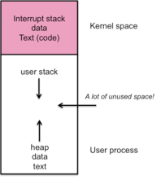
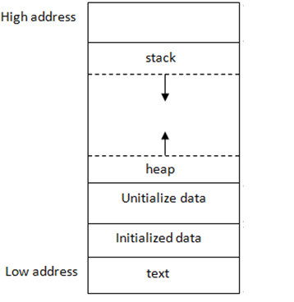
Stack and Heap
Stack and Heap both stored in the computer's RAM .

Slide 37
Linked List

Slide 38
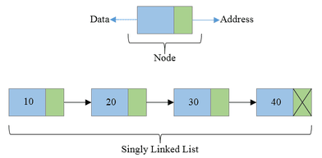
Linked Lists
Linear Collection of data elements called Nodes
Linear order is given by means of pointers.

Slide 39
Linked Lists
Each node may be divided into atleast two fields for :
Storing Data
Storing Address of next element.

Slide 40
Linked Lists
The Last node’s Address field contains Null rather than a valid address.
It’s a NULL Pointer and indicates the end of the list.

Slide 41
Comparison between Array and Linked List

Slide 42
Advantages of Linked List
Linked are Dynamic Data Structures
Grow and shrink during execution of the program
Efficient Memory Utilization
As memory is not preallocated.
Memory can be allocated whenever required and deallocated when not needed.
Insertion and deletions are easier and efficient
Provide flexibility in inserting a data item at a specified position and deletion of a data item from the given position
Many complex applications can be easily carried out with linked lists

Slide 43
Disadvantages of Linked List
Access to an arbitary data item is little bit cumbersome and also time consuming
More memory
If the number of fields are more, then more memory space is needed.

Slide 44
Advantages of Arrays
Simple to use and define
Supported by almost all programming languages
Constant access time
Array element can be accessed a[i]
Mapping by compiler
Compiler maps a[i] to its physical location in memory.
This mapping is carried out in constant time, irrespective of which element is accessed

Slide 45
Arrays suffer from some severe limitations
Disadvantages of Arrays
Static Data Structure-
Size of an array is defined at the time of programming
Insertion and Deletion is time consuming
Requires Contiguous memory

Slide 46
Types of Linked List
Singly Linked List
Doubly Linked List
Circular Linked List

Slide 47
Singly Linked List
All nodes are linked in sequential manner
Linear Linked List
One way chain
It has beginning and end

Slide 48
Singly Linked List
Problem-
The predecessor of a node cannot be accessed from the current node.
This can be overcome in doubly linked list.

Slide 49
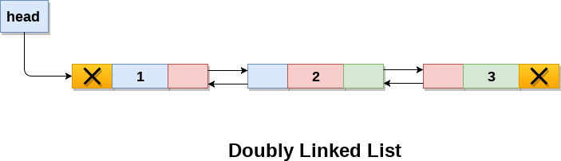
Doubly Linked List
Linked List holds two pointer fields
Addresses of next as well as preceding elements are linked with current node.
This helps to traverse in both Forward or Backward direction

Slide 50
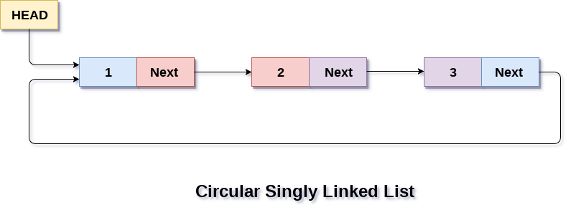
Circular Linked List
The first and last elements are adjacent.
A linked list can be made circular by
Storing the address of the first node in the link field of the last node.

Slide 51
Linked List Operations
Creation
Insertion
Deletion
Traversal
Searching

Slide 52
Implementation of Linked Lists
Structures in C are used to define a node
Address of a successor node can be stored in a pointer type variable

Slide 53
Linked Lists
Struct Basics
Struct Syntax
Struct examples
Pointer to structure
Sample Programs for Pointer to structures
Initialization of Pointers to Structures

Slide 54
Linked Lists
Information field
struct node
{
int info;
struct node *link;
}
Pointer that points to the structure itself,
Thus Linked List.

Slide 55
Singly Linked List

Slide 56
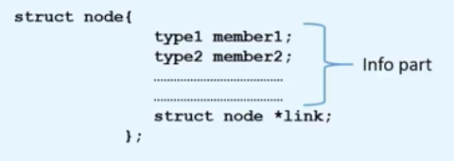
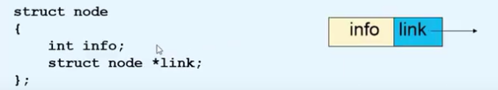

Creation of a new node

Slide 57
Creation of a new node
New node=temp
struct node *tmp;
tmp= (struct node *) malloc(sizeof(struct node));
tmp->info=data;
tmp->link=NULL;

Slide 58
Creating a Linked List
create_list(int data)
{
struct node *q,*tmp;
tmp= (struct node *) malloc(sizeof(struct node));
tmp->info=data;
tmp->link=NULL;
if(start==NULL) /*If list is empty */
{
start=tmp;
}
else
{ /*Element inserted at the end */
q=start;
while(q->link!=NULL)
{
q=q->link;
}
q->link=tmp;
}
}/*End of create_list()*/
Notes:
More like INSERTING A NODE AT THE END OF THE LL
Made a node, had a pre existing ll, searched for null in ll, pointer of null in ll points to new node temp

Slide 59
Explanation-
if(start==NULL) /*If list is empty */
{
start=tmp;
}

Slide 60
Explanation-
else
{ /*Element inserted at the end */
q=start;
while(q->link!=NULL)
{
q=q->link;
}
q->link=tmp;
}

Slide 61
Traversing a Linked List
Visit the node and print the data value

Slide 62
Traversing a Linked List
Assign the Value of start to another pointer say q
struct node *q=start;
Now q also points to the first element of linked list.
For processing the next element, we assign the address of the next element to the pointer q as-
q=q->link;
Traverse each element of the Linked list through this assignment until pointer q has NULL address, which is link part of last element.
while(q->link !=NULL)
{
q=q->link;
}
Notes:
q = q’s link
Computes q’s link and rewrites that as q’s new value

Slide 63
Explanation-
struct node *q=start;
while(q !=NULL)
{
q=q->link;
}

Slide 64
Algorithm for Traversing a Linked List
Step 1:[INITIALIZE] SET PTR=START
Step 2: Repeat Steps 3 and 4 while PTR!=NULL Step 3: Print PTR->INFO
Step 4: Set PTR=PTR->LINK
[End of Loop] Step 5 :EXIT
Notes:
Difference in WHILE CONDITION code is bcoz of PRINT STATEMENT

Slide 65
Algorithm for Counting the number of elements in a Linked List
Step 1:[INITIALIZE] SET COUNT=0
Step 2:[INITIALIZE] SET PTR=START
Step 3: Repeat Steps 4 and 5 while PTR!=NULL Step 4: Set COUNT=COUNT +1
Step 5: Set PTR=PTR->LINK
[End of Loop] Step 6:Print COUNT
Step 7:EXIT

Slide 66
Searching a Linked List
First traverse the linked list
While traversing compare the info part of each element with the given element

Slide 67
Searching a Linked List
search(int data)
{
struct node *ptr = start;
int pos = 1;
while(ptr!=NULL)
{
if(ptr->info==data)
{
printf("Item %d found at position %d\n",data,pos);
return;
}
ptr = ptr->link;
pos++;
}
if(ptr == NULL)
printf("Item %d not found in list\n",data);
}/*End of search()*/

Slide 68
Algorithm for Searching a Linked List
Step 1:[INITIALIZE] SET POSITION=1
Step 2:[INITIALIZE] SET PTR=START
Step 3: Repeat Step 4 while PTR!=NULL Step 4: If DATA=PTR->INFO
Print POSITION
Exit
[End of If]
Set PTR=PTR->LINK
Set POSITION=POSITION +1
[End of Loop] Step 5:If PTR=NULL
Print Search Unsuccessful
[End of If]
Step 6: Exit

Slide 69
Insertion into a Linked List
Insertion is possible in two ways:
Insertion at Beginning
Insertion in Between

Slide 70
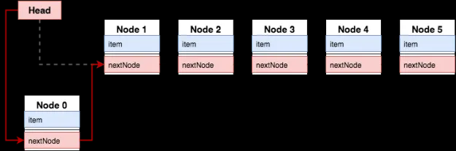
Case 1- Insertion at Beginning

Slide 71
Case 1- Insertion at Beginning
CREATE THE NEW NODE,
CONNECT NEW NODE TO THE OLD FIRST NODE
CONNECT THE START POINTER TO THE NEW NODE,
……

Slide 72
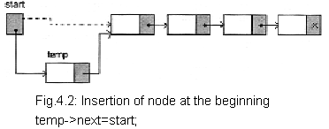
Case 1- Insertion at Beginning
Order?

Slide 73
Case 1- Insertion at Beginning
2
1
Order?

Slide 74
Case 1- Insertion at Beginning
Lets say tmp is the pointer which points to the node that has to be inserted
Assign data to the new node
tmp->info=data;
Start points to the first element of linked list
Assign the value of start to the link part of the inserted node as
tmp->link=start;
Now inserted node points beginning of the linked list.
To make the newly inserted node the first node of the linked list:
start=temp

Slide 75
Algorithm for Insertion at Beginning in a Linked List
First check whether Memory is available for the new node.
If the memory has exhausted then an Overflow message is printed
Else We allocate memory for the new node

Slide 76
Algorithm for Insertion at Beginning in a Linked List
Step 1: Allocate space to TEMP
Step 2: If TEMP=NULL Then
WRITE OVERFLOW
Go to Step 6
[End of If]
Step 3: Set TEMP->INFO=DATA
Step 4: Set TEMP->LINK=START
Step 5 : Set START=TEMP
Step 6 :EXIT
Notes:
Allocate space with malloc or calloc

Slide 77
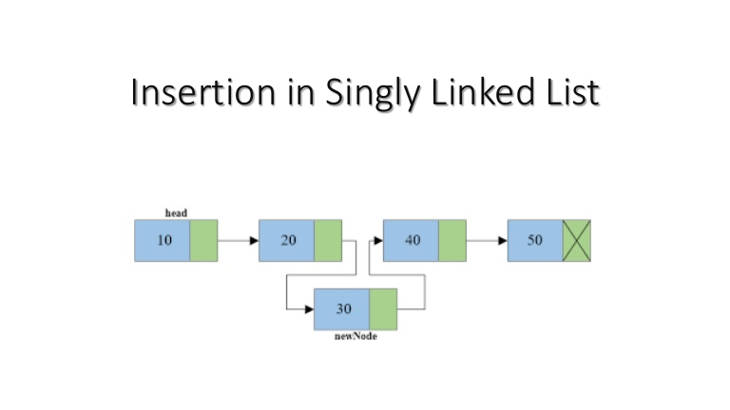
Case 2- Insertion in Between
2
1
Order?

Slide 78
Case 2- Insertion in Between
CREATE THE NEW NODE ,
CONNECT THE NEW NODE TO THE NEXT NODE
CONNECT THE PREVIOUS TO THE NEW NODE,
……

Slide 79
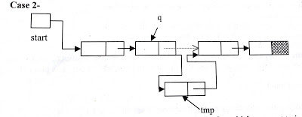
Case 2- Insertion in Between
First we traverse the linked list for obtaining the node after which we want to insert the element
q=start;
for(i=0;i<pos-1;i++)
{
q=q->link;
if(q==NULL)
{
printf("There are less than %d elements",pos);
return;
}
}/*End of for*/

Slide 80
Explanation-
q=start;
for(i=0;i<pos-1;i++)
{
q=q->link;
if(q==NULL)
{
printf("There are less than %d elements",pos);
return;
}
}/*End of for*/

Slide 81
Case 2- Insertion in Between
Then we add the new node by adjusting address fields
tmp->info=data;
tmp->link=q->link;
q->link=tmp;

Slide 82
Algorithm for Insertion in Between
Step 1: Allocate space to TEMP
Step 2: :If TEMP=NULL Then
WRITE OVERFLOW
Go to Step 13
[End of If] Step 3: Set TEMP->INFO=DATA
Step 4: Set TEMP->LINK=NULL
Step 5 : Read POSITION from User
Step 6 : Set Q=START
Step 7 : Set I=0
Step 8 : Repeat step 9 till I<POS-1
Step 9: Set Q=Q->LINK
If Q=NULL Print Less Number of Elements
Exit
[ End of If ]
SET I=I+1
[End of Loop]
Step 10:Set TEMP->LINK=Q->LINK
Step 11:Set Q->LINK=TEMP
Step 12:Exit
Step 7 :EXIT
q=start;
for(i=0;i<pos-1;i++)
{
q=q->link;
if(q==NULL)
{
printf("There are less than %d elements",pos);
return;
}
}/*End of for*/

Slide 83
Case 3- Insertion at the end
Without Using Position ?
At the end?

Slide 84
Case 3- Insertion at the end
Then we add the new node by adjusting address fields
tmp->info=data;
tmp->link=NULL;
q->link=tmp;

Slide 85
Algorithm for Insertion at the end of a Linked List
Step 1: allocate space to TEMP
Step 2: If TEMP=NULL Then
WRITE OVERFLOW
Go to Step 10
[End of If] Step 3: Set TEMP->INFO=DATA
Step 4: Set TEMP->LINK=NULL
Step 5 : Set Q=START
Step 6 : Repeat step 7 while Q->LINK!=NULL
Step 7: SET Q=Q->LINK
[End of Loop]
Step 8 : SET Q->LINK=TEMP
Step 9 : EXIT

Slide 86
Deletion from a Linked List
For deleting the node from a linked list, first we traverse the linked list and compare with each element.
After finding the element there may be two cases for deletion-
Deletion in beginning
Deletion in between

Slide 87
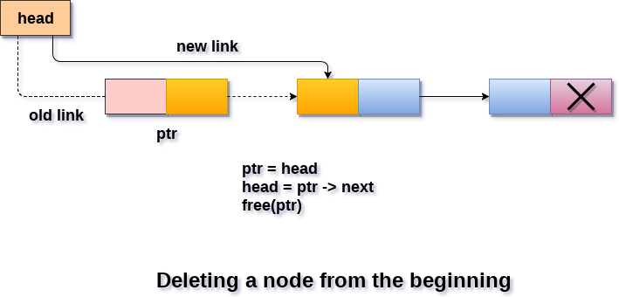
Deletion in beginning

Slide 88
Deletion in beginning
CONNECT
START POINTER TO THE SECOND NODE……
DELETE THE FIRST NODE

Slide 89
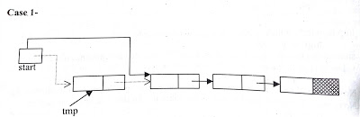
Deletion in beginning
Start points to the first element of linked list.
If element to be deleted is the first element of linked list then we assign the value of start to tmp as-
tmp = start;
So tmp points to the first node which has to be deleted.
Now assign the link part of the deleted node to start as-
start=start->link;
Since start points to the first element of linked list, so start->link will point to the second element of linked list.
Now we should free the element to be deleted which is pointed by tmp. free( tmp );

Slide 90
Algorithm for Deletion in the beginning of the Linked List
Step 1:If START=NULL
Step 2: Write UNDERFLOW
Step 3: Go to Step 7
[End of If]
Step 4: Set TEMP=START
Step 5: Set START=START->LINK
Step 6:FREE TEMP
Step 7:EXIT

Slide 91
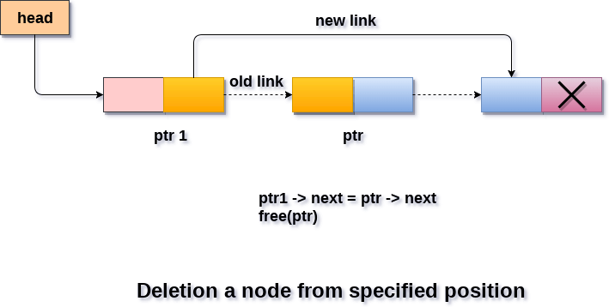
Deletion in between

Slide 92
Deletion in between
1)CONNECT
THE PREVIOUS AND THE NEXT NODE……
2)DELETE THE NODE

Slide 93
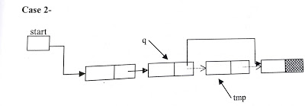
Deletion in between

Slide 94
Deletion in between
If the element is other than the first element of linked list then
we give the link part of the node to be deleted to the link part of the previous node.
This can be as-
tmp =q->link;
q->link = tmp->link;
free(tmp);

Slide 95
Deletion at the end
If node to be deleted is last node of linked list then statement 2 will be as-
tmp =q->link;
q->link = NULL;
free(tmp);

